Slide 1
Python Programming - V
- By Nimesh Kumar Dagur

Slide 2
Python Modules
A module allows you to logically organize your Python code.
Grouping related code into a module makes the code easier to understand and use.
A module is a Python object with arbitrarily named attributes that you can bind and reference.
Simply, a module is a file consisting of Python code. A module can define functions, classes and variables.

Slide 3
Python Modules
Modules refer to a file containing Python statements and definitions.
A file containing Python code, for e.g.: example.py, is called a module and its module name would be example.
We use modules to break down large programs into small manageable and organized files.
Furthermore, modules provide reusability of code.
We can define our most used functions in a module and import it, instead of copying their definitions into different programs.

Slide 4
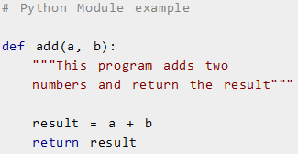
Example
Type the following and save it as example.py.
Here, we have defined a function add() inside a module named example

Slide 5

Importing modules
We can import the definitions inside a module to another module or the interactive interpreter in Python.
You can use any Python source file as a module by executing an import statement in some other Python source file.
We use the import keyword to do this.

Slide 6

Importing modules: example
To import our previously defined module example we type the following in the Python prompt.
>>> import example
This does not enter the names of the functions defined in example directly in the current symbol table.
It only enters the module name example there.
Using the module name we can access the function using dot (.) operation.

Slide 7
Importing modules
When the interpreter encounters an import statement, it imports the module if the module is present in the search path.
A search path is a list of directories that the interpreter searches before importing a module.
A module is loaded only once, regardless of the number of times it is imported.
This prevents the module execution from happening over and over again if multiple imports occur.

Slide 8
Importing modules
Python has a ton of standard modules available.
You can check out the full list of Python standard modules and what they are for.
These files are in the Lib directory inside the location where you installed Python.
Standard modules can be imported the same way as we import our user-defined modules.

Slide 9
Importing modules
There are various ways to import modules:
The import statement
Import with renaming
The from...import statement
Import all names by using the from...import * Statement

Slide 10
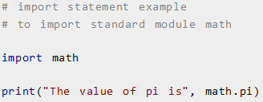
The import statement

Slide 11
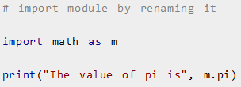
Import with renaming

Slide 12

The from...import statement
Python's from statement lets you import specific attributes from a module into the current namespace.
Syntax:

Slide 13
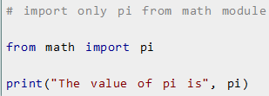
The from...import statement

Slide 14
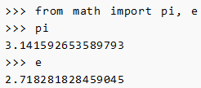
The from...import statement

Slide 15

Import all names
It is also possible to import all names from a module into the current namespace by using the following import statement:

Slide 16
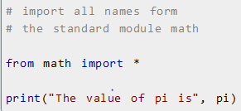
Import all names
We imported all the definitions from the math module. This makes all names except those beginning with an underscore, visible in our scope.

Slide 17
Python Module Search Path – Locating Module
While importing a module, Python looks at several places.
Interpreter first looks for a built-in module then (if not found) into a list of directories defined in sys.path.
The search is in this order:
The current directory.
PYTHONPATH (an environment variable with a list of directory).
The installation-dependent default directory.

Slide 18
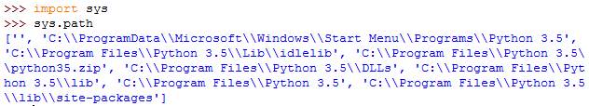
Python Module Search Path – Locating Module

Slide 19
Reloading a module
The Python interpreter imports a module only once during a session.
This makes things more efficient.
Example: code in a module named my_module
print("This code got executed")
Module1.py
Test.py
Add(x,y)
Sub(x,y)
import Module1
Module1.
Import Module1
Mul()
Div()

Slide 20

Reloading a module: example
Effect of multiple imports:
We can see that our code got executed only once.
This goes to say that our module was imported only once.

Slide 21
Reloading a module
Now if our module changed during the course of the program, we would have to reload it.
One way to do this is to restart the interpreter.
But this does not help much.
Python provides a neat way of doing this.
Use the reload() function inside the imp module to reload a module.
But Now in latest Python 3 version, we use importlib in place of imp.

Slide 22
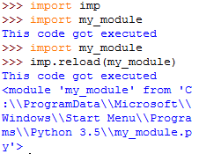
Reloading a module: Example

Slide 23
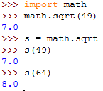
Assigning functions to variables

Slide 24


The dir() built-in function
We can use the dir() function to find out names that are defined inside a module
Example: we have defined a function add() in the module example in previous slides.
Here, we can see a sorted list of names (along with add).
All other names that begin with an underscore are default Python
attributes associated with the module .
For example, the __name__ attribute contains the name of the
module

Slide 25
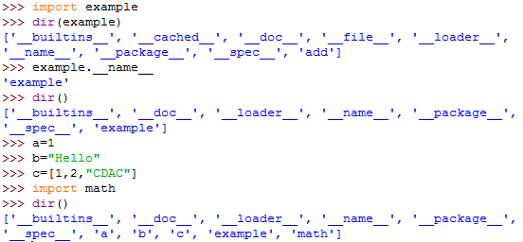
The dir() built-in function
All the names defined in our current namespace can be found out using the dir() function without any arguments.

Slide 26
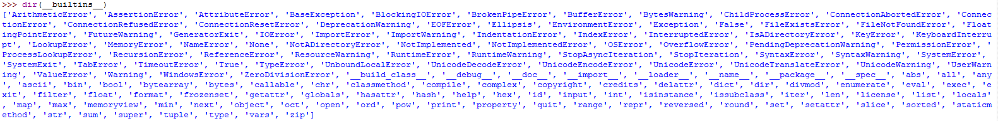
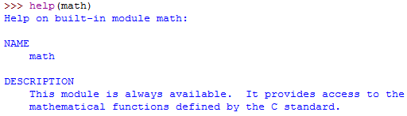
The dir() and help() built-in function
dir(__builtins__) is used to list all built-in functions
help() is used to Show help menu for an imported module.

Slide 27
__name__ in Python
Since there is no main() function in Python, when the command to run a python program is given to the interpreter, the code that is at level 0 indentation is to be executed. However, before doing that, it will define a few special variables.
__name__ is one such special variable.
If the source file is executed as the main program, the interpreter sets the __name__ variable to have a value “__main__”.
If this file is being imported from another module, __name__ will be set to the module’s name.
__name__ is a built-in variable which evaluates to the name of the current module.
Thus it can be used to check whether the current script is being run on its own or being imported somewhere else by combining it with if statement,

Slide 28
Python Package

Slide 29
Python Package
We don't usually store all of our files in our computer in the same location.
We use a well-organized hierarchy of directories for easier access.
Similar files are kept in the same directory, for example, we may keep all the songs in the "music" directory.
Analogous to this, Python has packages for directories and modules for files.
As our application program grows larger in size with a lot of modules, we place similar modules in one package and different modules in different packages.
This makes a project (program) easy to manage and conceptually clear.
Similar, as a directory can contain sub-directories and files, a Python package can have sub-packages and modules.
A directory must contain a file named __init__.py in order for Python to consider it as a package.
This file can be left empty but we generally place the initialization code for that package in this file.

Slide 30
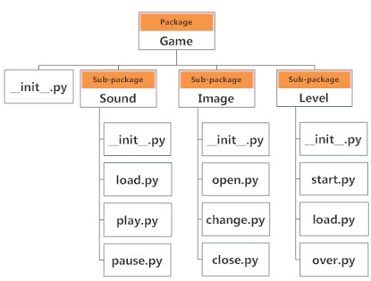
Example
Suppose we are developing a game, one possible organization of packages and modules could be as shown in the figure below.

Slide 31

Importing module from a package
We can import modules from packages using the dot (.) operator
if want to import the start module in the above example, it is done as follows.
Now if this module contains a function named select_difficulty(), we must use the full name to reference it.
While importing packages, Python looks in the list of directories defined in sys.path, similar as for module search path.

Slide 32
Working with Files in Python Programming
File is a named location on disk to store related information
While a program is running, its data is in memory.
When the program ends, or the computer shuts down, data in memory disappears.
To store data permanently, you have to put it in a File.
file is used to permanently store data in a non-volatile memory (e.g. hard disk).
Since, random access memory (RAM) is volatile which loses its data when computer is turned off, we use files for future use of the data.

Slide 33
Files are usually stored on a hard drive, floppy drive, or CD-ROM.
When there are a large number of files, they are often organized into directories (also called \folders").
Each file is identified by a unique name, or a combination of a file name and a directory name.
By reading and writing files, programs can exchange information with each other and generate printable formats like PDF.

Slide 34
Working with Files in Python Programming
Working with files is a lot like working with books.
To use a book, you have to open it. When you're done, you have to close it.
While the book is open, you can either write in it or read from it.
In either case, you know where you are in the book.
Most of the time, you read the whole book in its natural order, but you can also skip around.
All of this applies to files as well. To open a file, you specify its name and indicate whether you want to read or write.
Opening a file creates a file object.

Slide 35
Working with Files in Python Programming
In Python, a file operation takes place in the following order.
Open a file
Read or write (perform operation)
Close the file

Slide 36

Opening a File
Python has a built-in function open() to open a file.
This function returns a file object, also called a handle, as it is used to read or modify the file accordingly.
Opening a file creates what we call a file handle.
In this example, the variable f refers to the new handle object.
Our program calls methods on the handle, and this makes changes to
the actual file which is usually located on our disk.

Slide 37
Opening a File
We can specify the mode while opening a file.
In mode, we specify whether we want to read 'r', write 'w' or append 'a' to the file.
We also specify if we want to open the file in text mode or binary mode.
The default is reading in text mode.
In text mode, we get strings when reading from the file.
On the other hand, binary mode returns bytes and this is the mode to be used when dealing with non-text files like image or exe files.

Slide 38

Closing a File
When we are done with operations to the file, we need to properly close it.
Python has a garbage collector to clean up unreferenced objects.
But we must not rely on it to close the file.
Closing a file will free up the resources that were tied with the file and is done using the close() method.

Slide 39
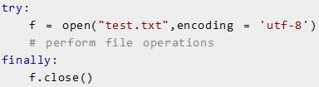
Closing a File
Previous method is not entirely safe.
If an exception occurs when we are performing some operation with the file, the code exits without closing the file.
A safer way is to use a try...finally block.
This way, we are guaranteed that the file is properly closed even if an exception is raised, causing program flow to stop.

Slide 40
Closing a File
The best way to do this is using the with statement.
This ensures that the file is closed when the block inside with is exited.
We don't need to explicitly call the close() method. It is done internally.

